Slide 1
Manufacturing Management System
A holistic solution for manufacturers

Slide 2
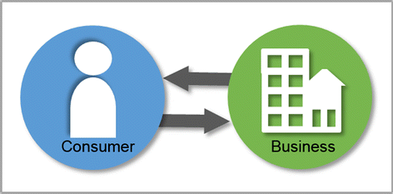
We aim to digitize the entire manufacturing ecosystem
Raw
Material 1
Product 1
Raw
Material 2
Raw
Material 3
Product2
Raw
Material 4
Manufacturing
Raw
Material 5

Slide 3
General problems
How many units to order?
When to order?
Whom to buy from?
How to store ?
Machine maintenance
Logistics
Customer care

Slide 4
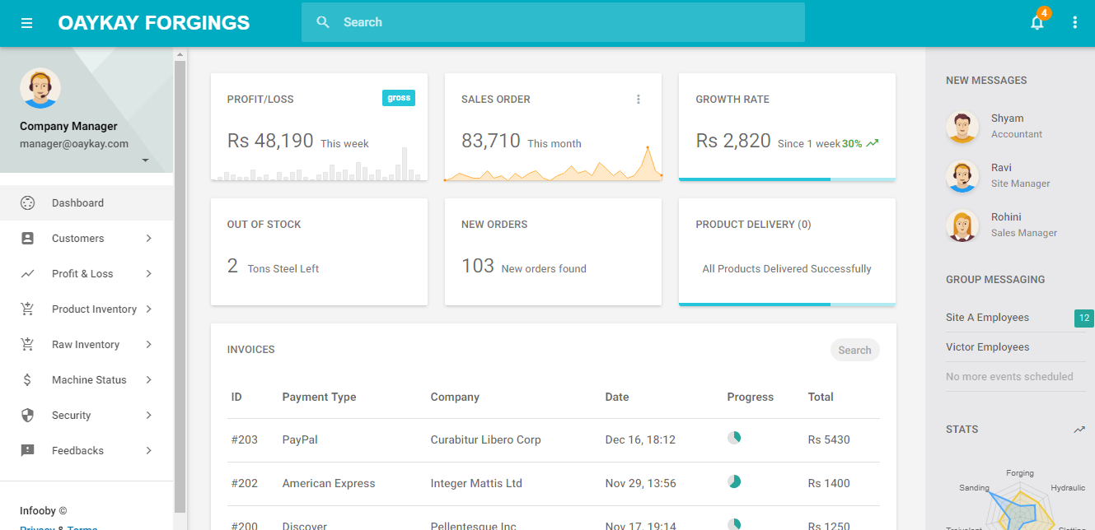
Dashboard

Slide 5
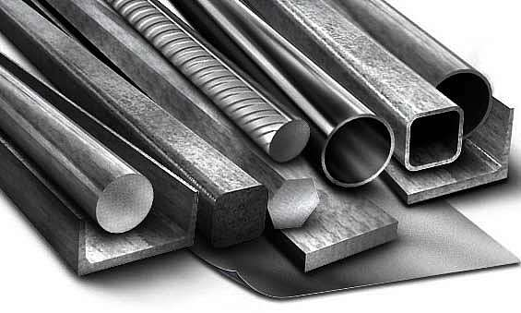
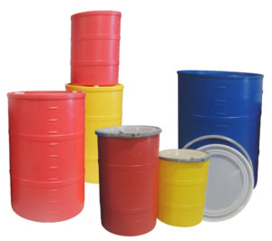
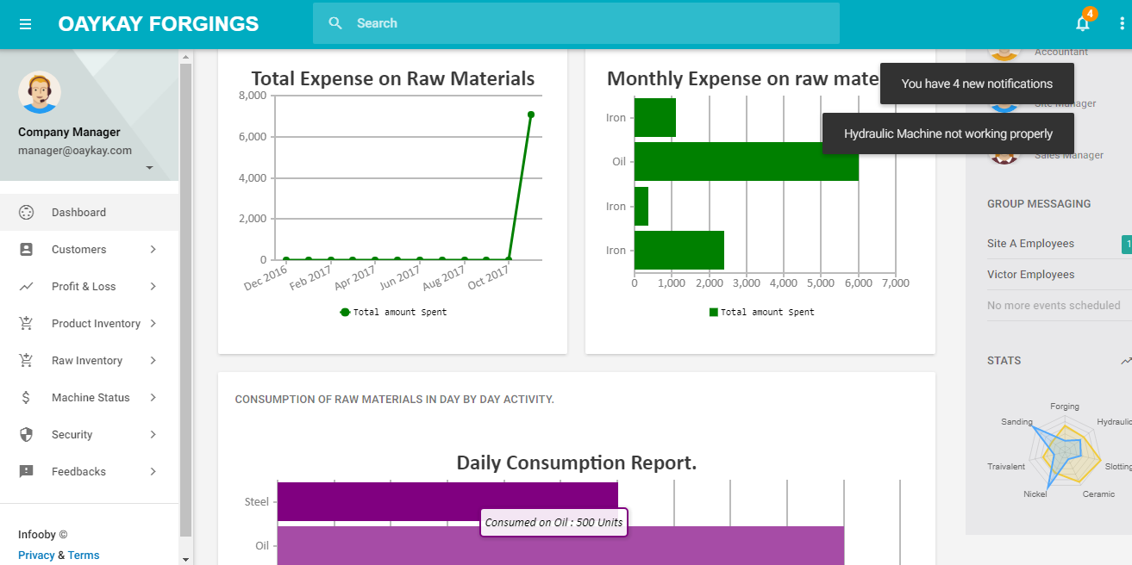
Inventory Management
Raw material stock details
Raw material consumption
Purchase details
Suppliers

Slide 6
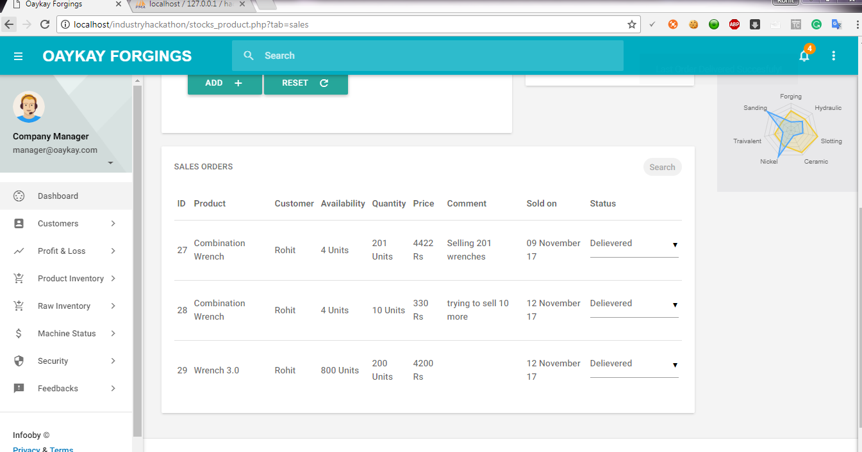
Product details and management
Product management
Product database
Order History

Slide 7
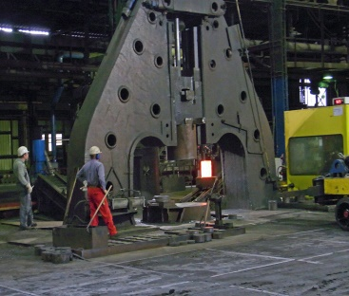
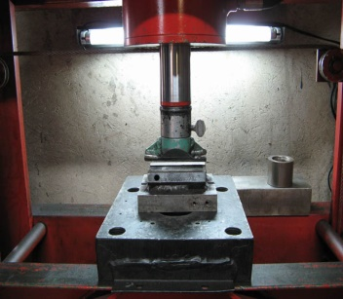
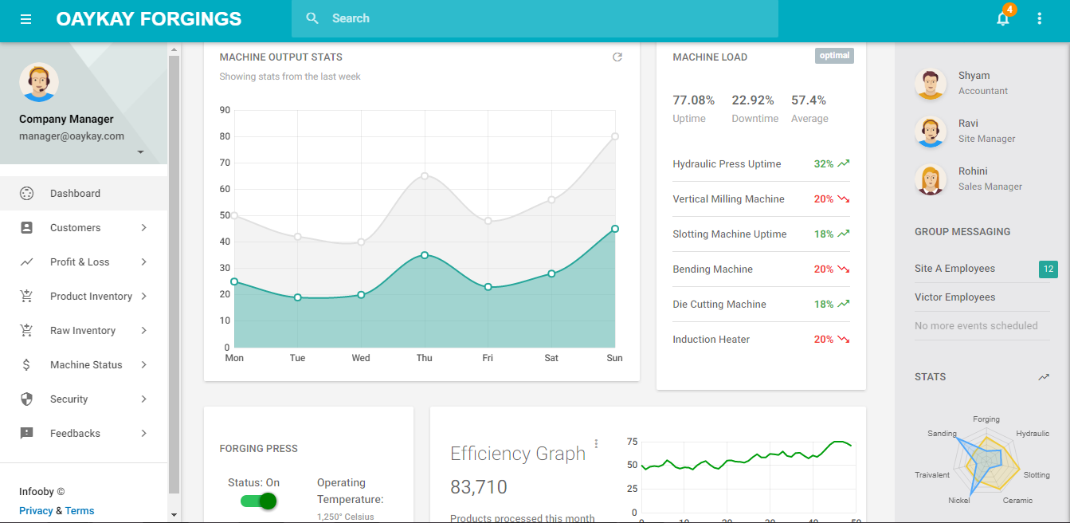
Machine status
Monitoring of machine
Efficiency of machine
Maintenance

Slide 8
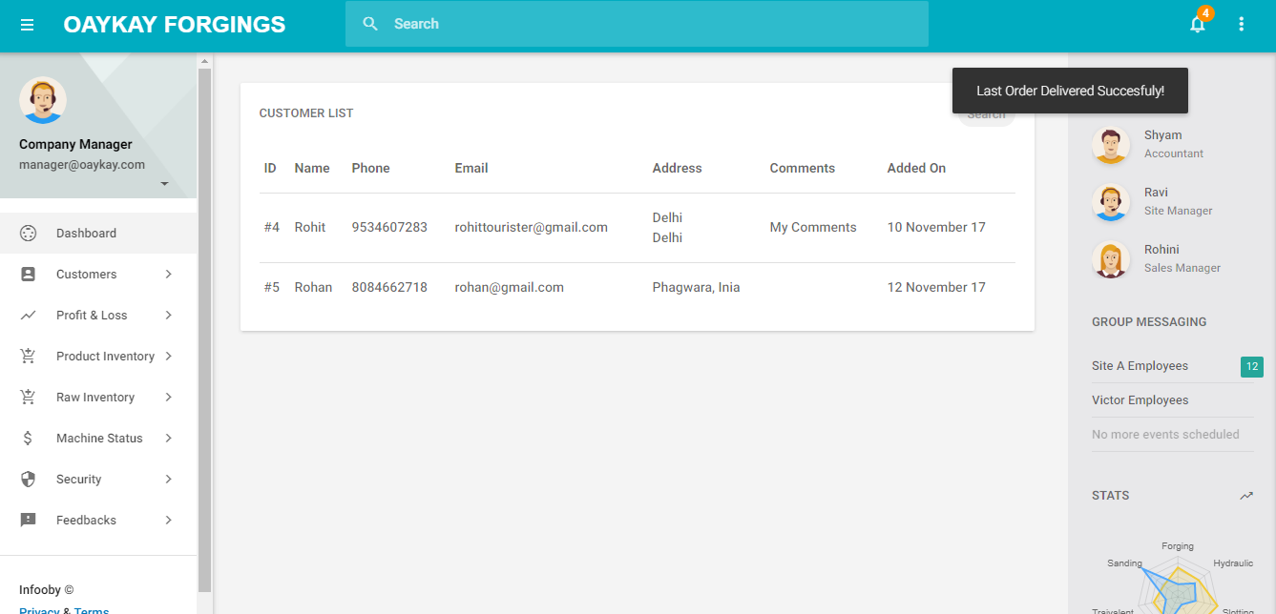
Customer relations
Customer details
feedback

Slide 9
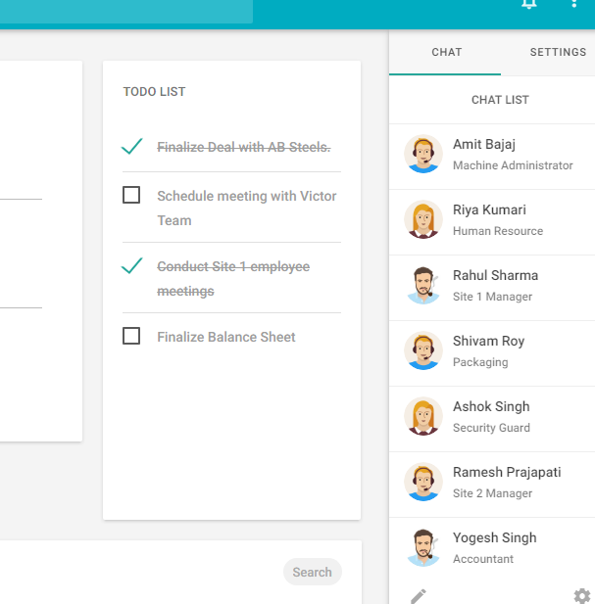
Employee management
Employee co-ordination
Management

Slide 10
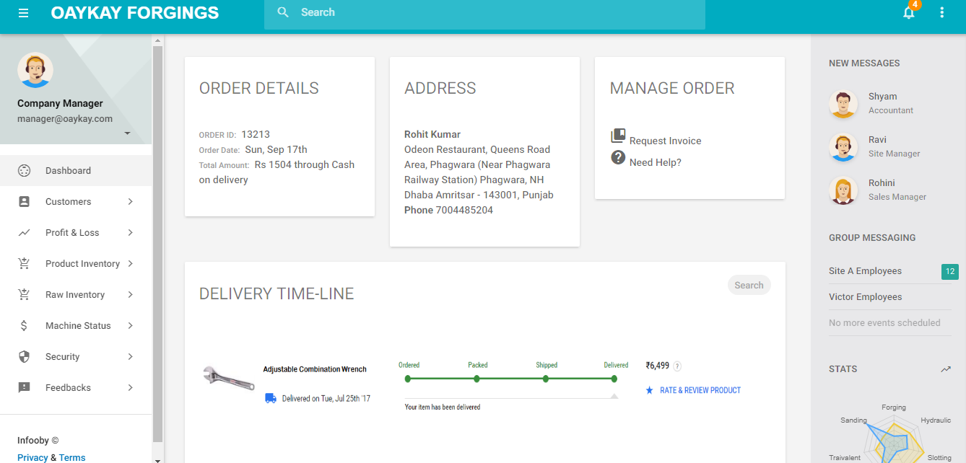
Logistics
Product packaging
Tracking
Delivery

Slide 11

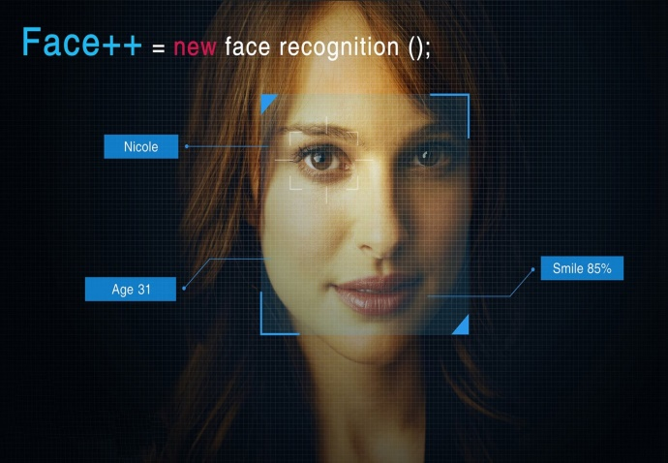
Security
CCTV database
Intruder footage
Facial recognition
Biometric authentication

Slide 12
IOT
All the data will be feeded in real time to the Manufacturing Management system with the help of various sensors

Slide 13
Project By Teams-
>404 Not Found
>NMSR

